Slide 1


Largue Neural language representation models for WSD
Iker García

Slide 2

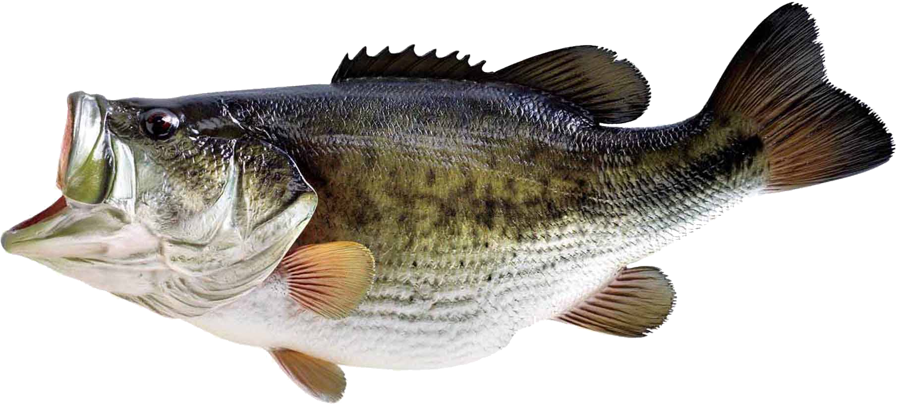
Word Sense Disambiguation
Bass:
A type of fish
Tones of low frequency
A type of instrument
…
I went fishing for some sea bass.
The bass line of the song is too weak.

Slide 3
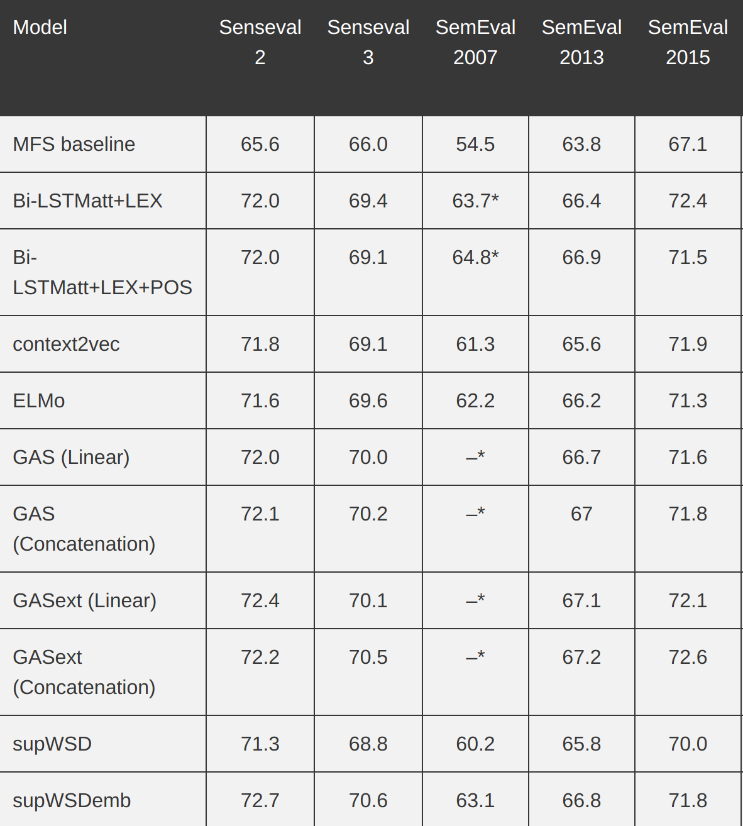

SOTA
Source:
http://nlpprogress.com/english/
word_sense_disambiguation.html

Slide 4
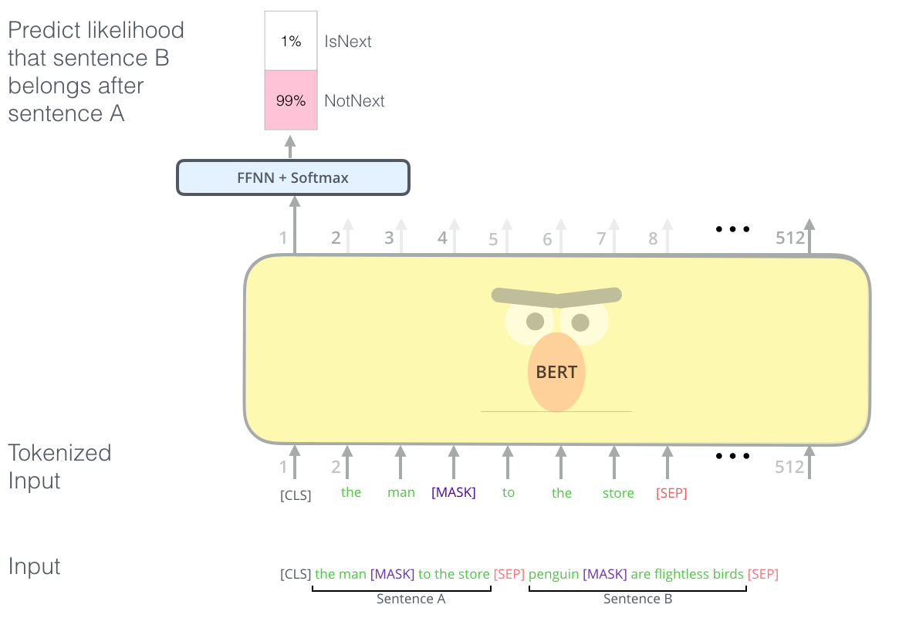
Large Neural Language representation models
BERT training: Source: http://jalammar.github.io/illustrated-bert/

Slide 5
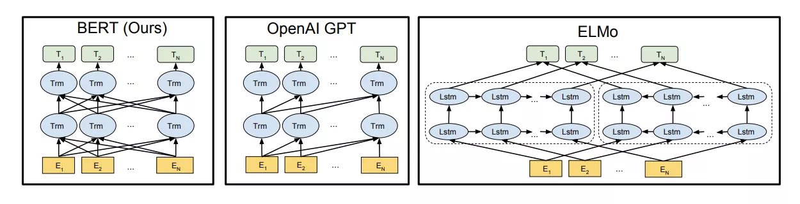
Large Neural Language representation models
BERT (Devlin et al. 2018)
OpenAI GPT2 (Radford et al. 2019)
ELMO (Peters et al. 2018)
XLNet (Yang et al. 2019). Released yesterday, better than BERT!!
Models explained: http://jalammar.github.io/illustrated-bert/

Slide 6
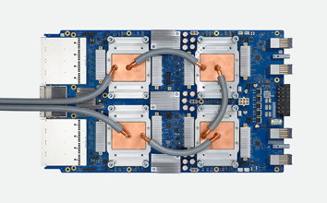
Huge amount of training data!!!!
GPT2 Large:
40 GB Corpus
32 Google Cloud TPU V3

Slide 7
Huge amount of training data!!!!
40GB of Data ~= 5.834.564.596 words ~= 38639500 pages

Slide 8

Huge amount of training data!!!!
40GB of Data ~= 5.834.564.596 words ~= 38639500 pages
6182.32 meters
As tall as 7,5 Burj Khalifa (828m) stacked one on top of the other!!

Slide 9
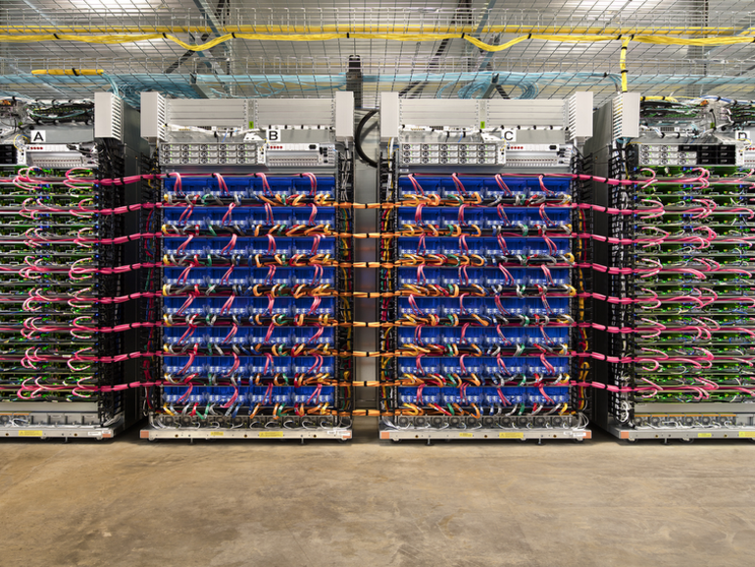
Huge amount of training data!!!!
32 Google Cloud TPU V3 = 13440 Tflops (The GPUs inside the computers on this class have 2 Tflops…)
Training GPT2 using Google Cloud cost around 43K $

Slide 10
Large Neural Language representation models
Sota in in a large variety of NLP tasks:
Question answering
Machine translation
Commonsense Inference
Semantic Textual Similarity Benchmark
Recognizing Textual Entailment
Sentiment Analysis
More...

Slide 11
Let's try it!!
GPT2: https://talktotransformer.com/

